Slide 1
Deimos
An ancient greek Monster-hunting Action Platformer

Slide 2
What’s this game all about?
Pandora has released monsters into the world.
You are a bounty hunter tasked with cleaning up the mess.
Learn about the different monsters of ancient greece and then either kill or capture them.
Fight your way through ten beautifully designed maps, searching for the monsters that have been released.

Slide 3
How are going to make this game?
We are going to make this game in unity.
We’ll get artist to design characters and levels.
Once the design are done we’ll put it all together in unity

Slide 4
Why are we making this game?
We are very interested in greek mythology
We noticed that there is a lack of games about Pandora’s box
We decided that we were going to make the game we wanted to see.

Slide 5
Key Facts
Platforms - PC, Mac, Linux, Xbox, Playstation, Nintendo Switch
Genre - Action adventure platformer
Made in Unity
Monetisation - Full release €20, DLC €5 Each
Players - Singleplayer campaign, Gladiator arena deathmatch for 1 to 4 players
Length - 20 hours, another 20 or so with New Game +
Release date - Coming Holiday 2023
Key people - Liam O’Shea, Alan Duggan

Slide 6
Specific Features
10 Unique maps
20 bosses
Detailed weapon and tool unlocks
New Game +
Arena mode player vs player
Currency system - Killed enemies drop gold, which can be exchanged for weapons and upgrades.
Encyclopaedia of monsters - Filled out upon killing monster, can also ask townspeople about the monsters to learn weaknesses before trying to hunt them.

Slide 7
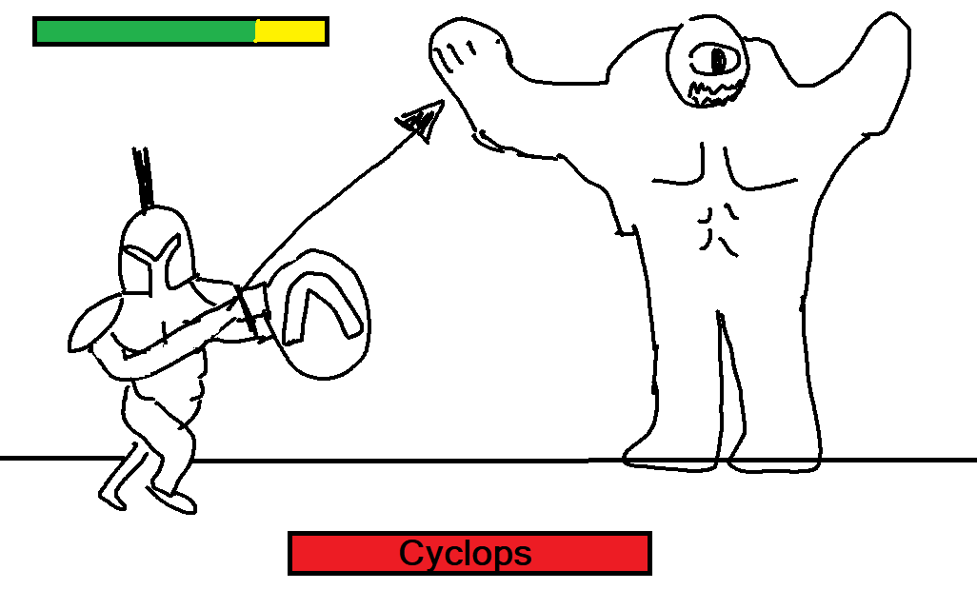
Mockup/Art

Slide 8
Thank you for listening to Our Pitch.

